Slide 1


Med - Trac App By Stephen Harney

Slide 2
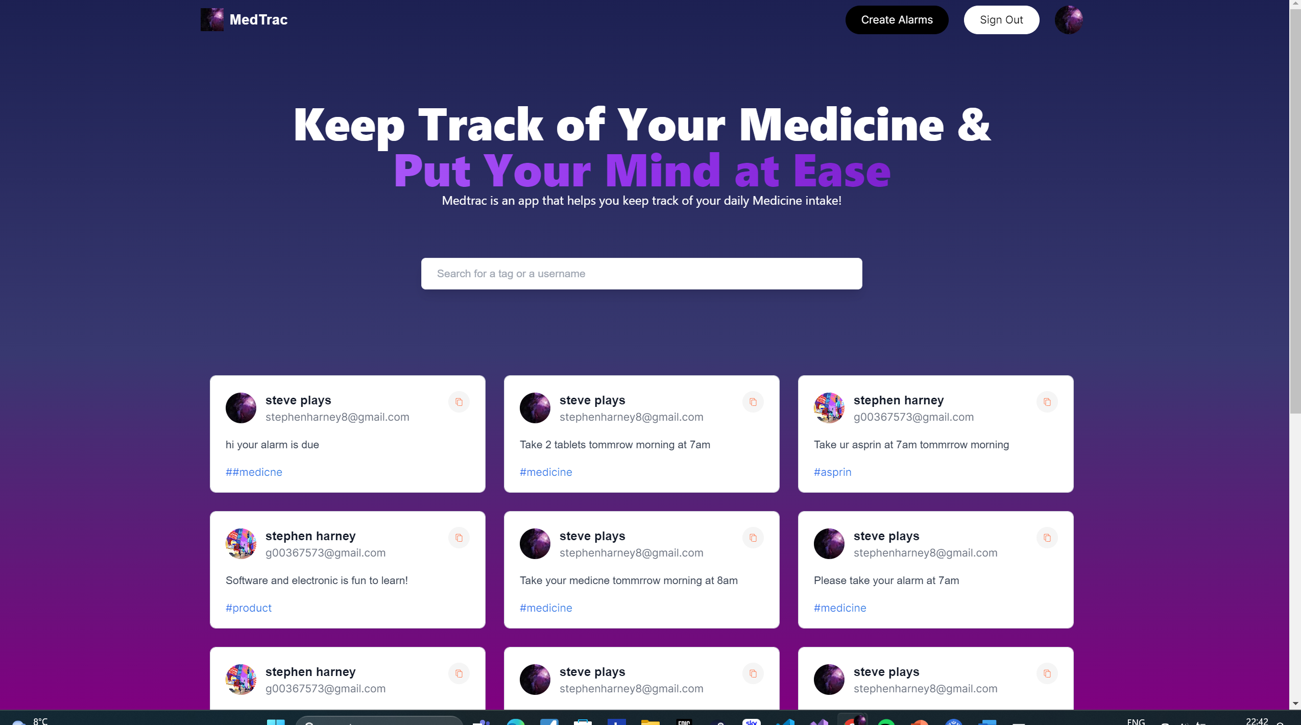

Slide 3
What is MedTrac app
Med Trac is a Web App, to help you track your medicine.
This helps the user to track their daily medicine from the web app.
The user would be able to create, delete and edit their alarms.

Slide 4
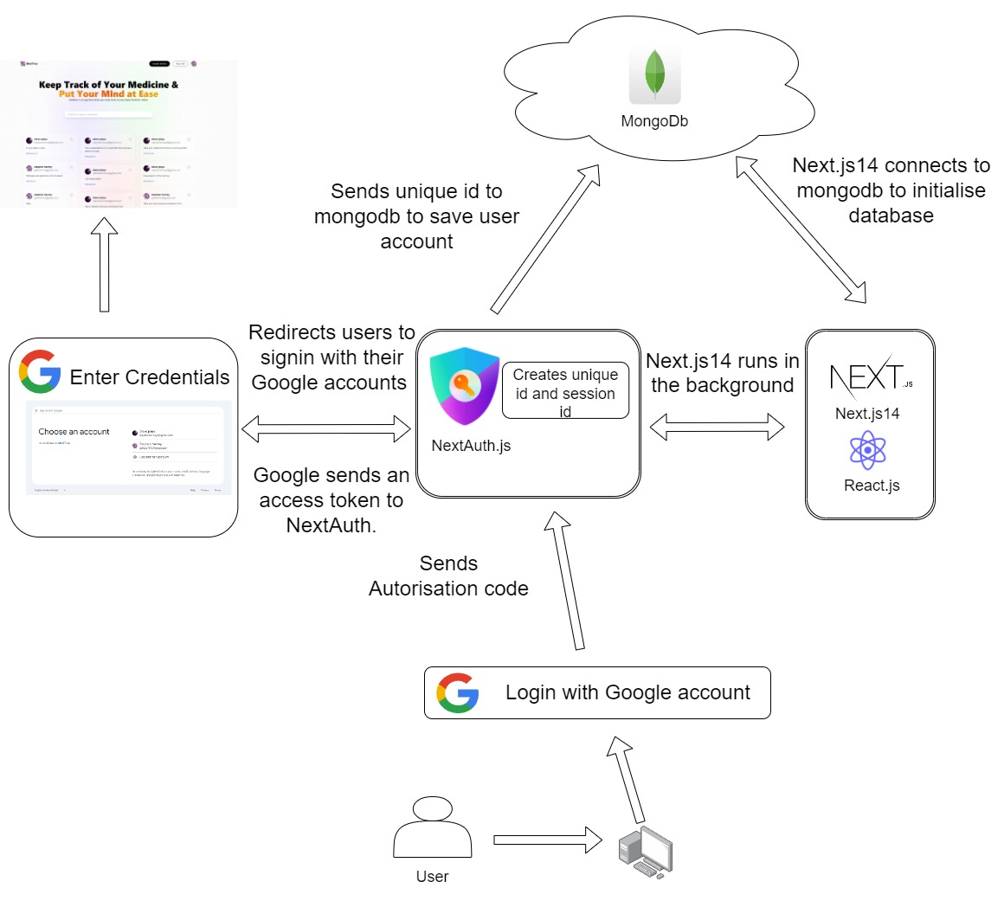
Architecture Diagram:

Slide 5
Technologies:
I am using Next.js14,
Mongo dB For server,
Google Cloud and NextAuth for user Authentication,
Tailwaind.CSS to style the web app .

Slide 6
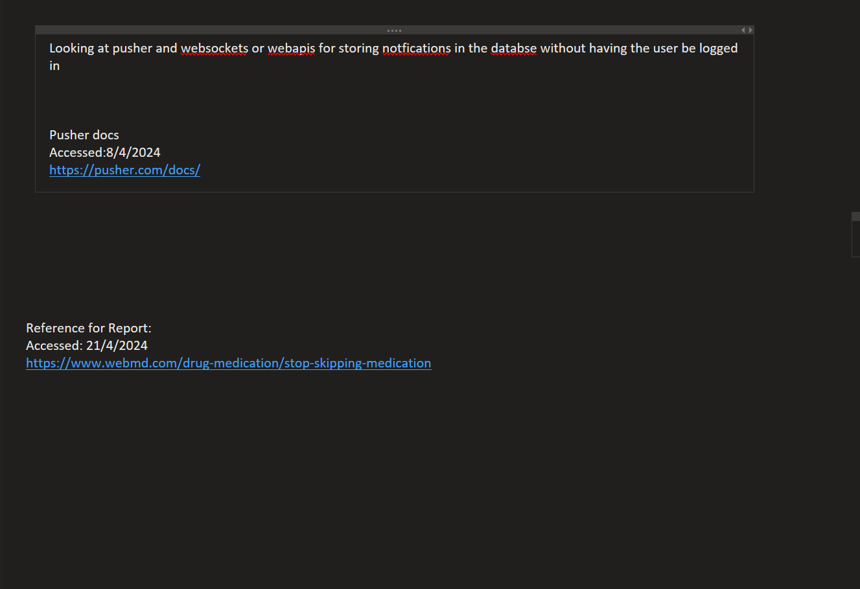
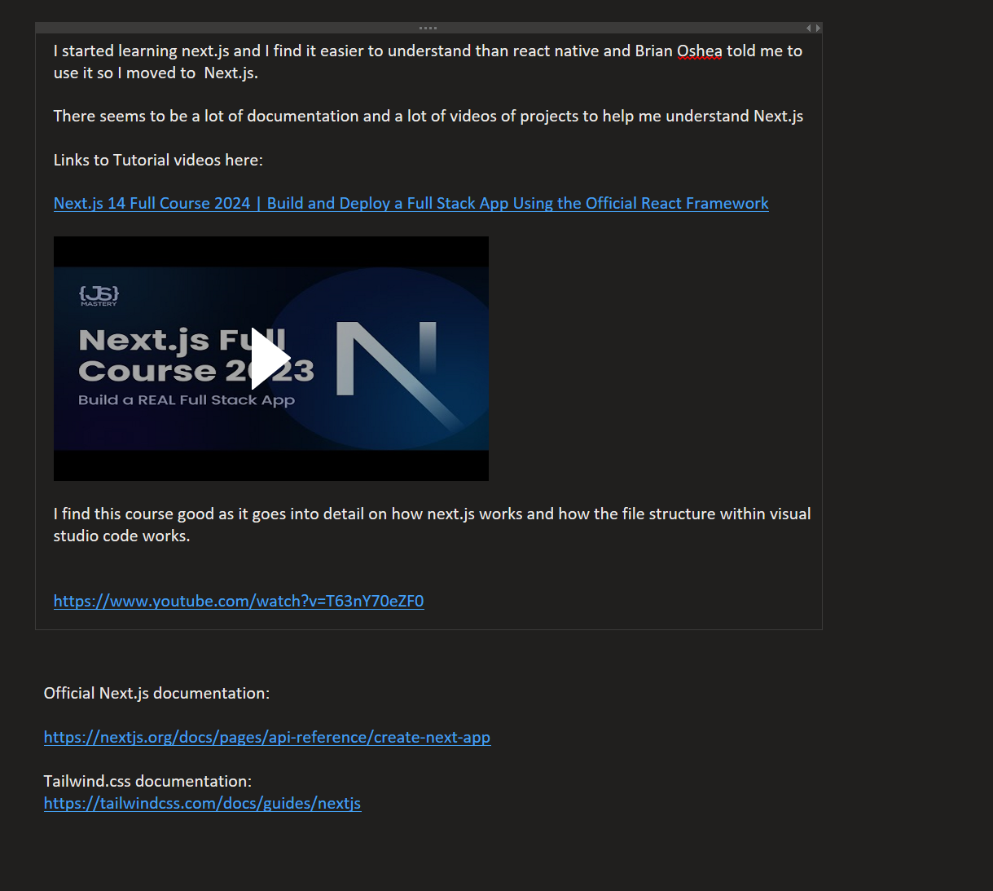
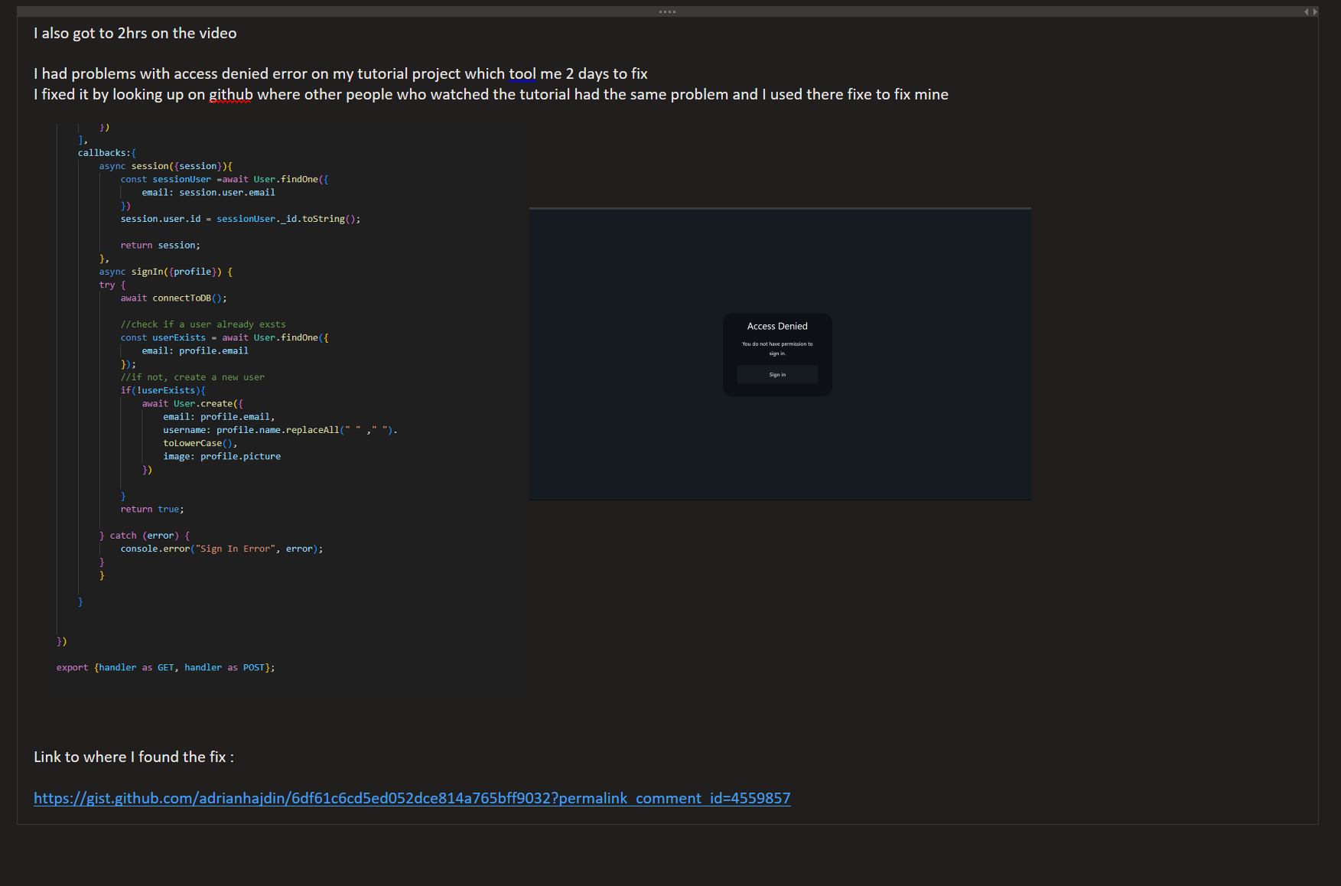
Organisation:
I am using Jira management project tool to keep track of my project.
For logging my progress, I used OneNote to log my Project progress weekly.
I use OneNote to save links to websites That I used or videos I watched so I can save them for references on my Report

Slide 7
Challenges
I used Figma/Canva to design the webapp. I have never designed a wireframe before for any app and it was taking me too long to make a wireframe for my webapp
Choosing technology to use for my project was challenging as I had to research their documentation, watch videos I eventually chosed Next.js14 for my web app for its API Routes.
I used time management tools like Jira. I found myself still being overwhelmed by the course work which led me not finishing what I had planned.
Learning a new framework like Next,js14 was a learning curve for me.
Adding Google Cloud took time as I was getting an access denied error. I added the replace all method to replace all the characters within the username to allow access to my web app.
GitHub was a learning curve for me as I never used it before.
I kept getting a push protection error for secrets. Even though this was in my ENV file, and it was hidden to my gitignore.
I had to make a new project and added my previous code into it this worked as I believe that my past branches had the env file not hidden and it was messing up my branches and preventing them to pushing the code to my repository.

Slide 8
Conclusion
For the conclusion of my final year project. I improved on my programming skills by developing a webapp with Next.js14. There was numerous challenges I had to face like Research, time management. This helped me identify my weaknesses and helped me become a better engineer.
I added functionality to my web app like users can edit, create and delete their alarms, this makes the web app experience easy to use, and users can use their own Google accounts, this will allow their alarms to be saved in my MongoDB database.
Developing this webapp was a fun experience and challenging experience that helped me grow as an engineer.

Slide 9
Thanks For listening!!
Next the demonstration

